Slide 1
Self-supervised learning for visual tracking
Carlos Cuartas, Airi Shimamura, Mostofa Adib Shakib, Junwoo Jang, Jordan Ketring
Group 7

Slide 2
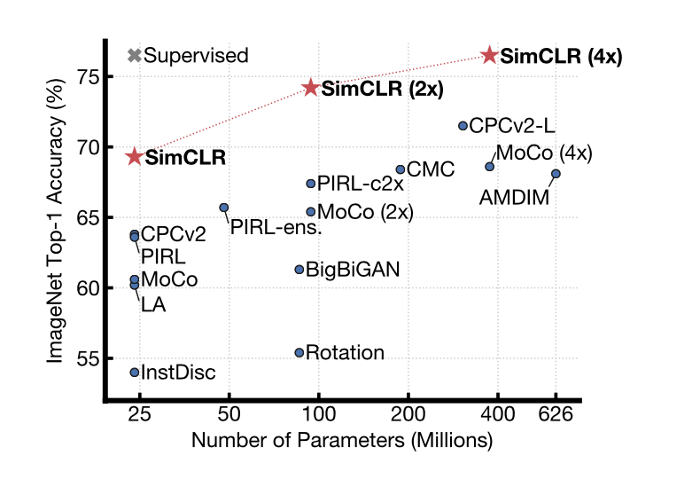
SimCLR: Strengths and Weaknesses
✓ Simple framework
✓ No specialized architectures or memory banks
✓ Use fewer labels
⤫ Requires a large batch size
General: From 25~30
SimCLR: From 256 to 8192
Gives us 16382 negative examples per positive pair
⤫ GPU memory issues
⤫

Slide 3
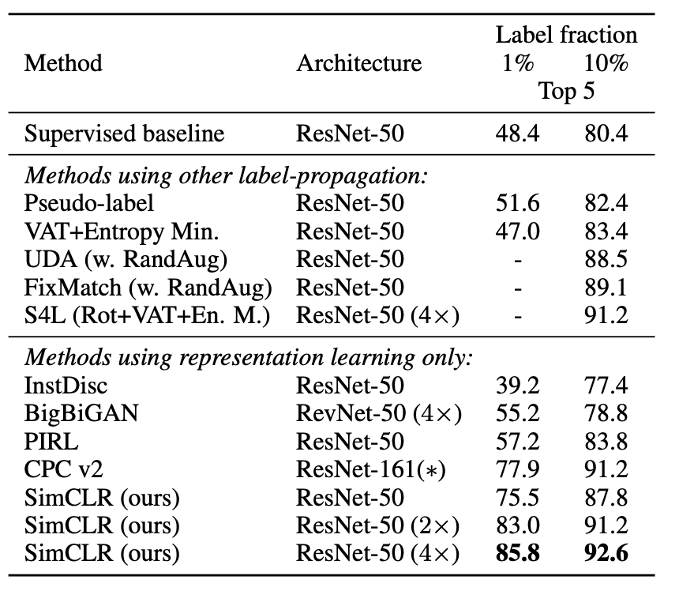
SimCLR: Benefits from larger batch sizes
No biases
Decreases the gaps between different batch sizes
Improves the results
Facilitates convergence

Slide 4
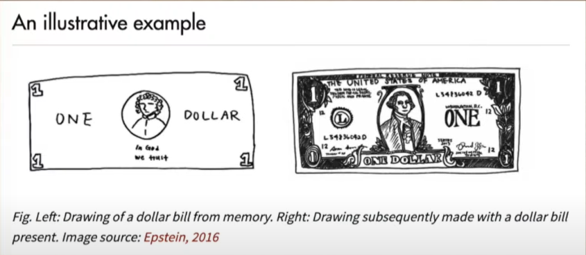
Contrastive vs Generative Learning
Humans do not store the full representation
Humans only represent a dollar bill enough to know it's a dollar bill and not a cat or a coffee cup

Slide 5

Method
Contrastive instance learning: Contrasting between multiple image views by comparing their cluster assignments instead of their features. Cluster assignment is achieved by assigning the features to a prototype vector and passing it through Sinkhorn Knopp
Online clustering: The code of the view of an image is predicted from the representation of another view of the same image. The rationale here is if two views are semantically similar, their codes should also be similar.
Multi-crop: SwAV uses an unique multi-crop augmentation policy where-in the same image is randomly cropped to get a pair of high resolution images and cropped to get additional views of low resolution images.

Slide 6
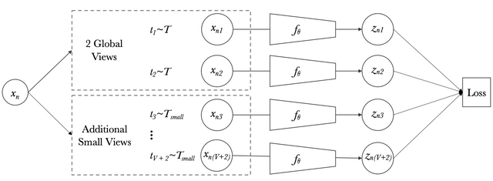
Multi-Crop Augmentation Policy
Two standard or high resolution (ex: 224x224) cropped images are generated
The strategy also samples 5 additional low resolution (ex: 96x96) image along with these two views
The use of low-resolution views ensures only a small increase in computing costs
Mapping small scenes with global views of the image can significantly boost performance

Slide 7
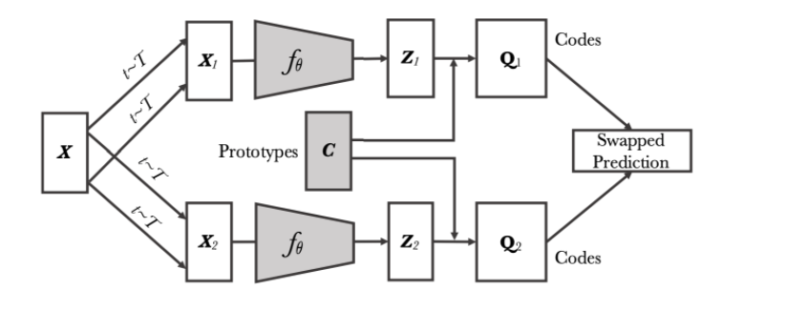
High-level overview of SwAV
Multiple views of a batch of images are generated
The views are passed through ResNet50 backbone
This embedding vector then goes to a shallow non-linear network.
The projection vector is fed to a single linear layer
Sinkhorn Knopp algorithm is used for cluster assignment and a swapped prediction problem is setup.

Slide 8
Advantage And Disadvantage Of SwaV:
Advantage:
SwAV method can scale to potentially unlimited amounts of data.
SwAV works with small and large batch sizes
Does not need a large memory bank
Disadvantage:
SwAV uses phases of knowledge installation and can be inefficient

Slide 9
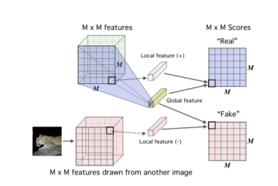
AMDIM (Augmented Multiscale Deep InfoMax)
DIM
Unsupervised learning technique whose purpose is maximizing mutual information
Mutual information
measure of how much the uncertainty of one variable is reduced when the other variable is known.

Slide 10
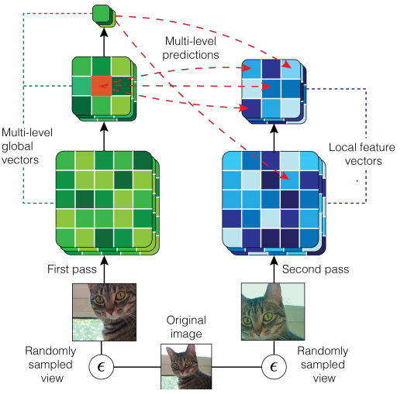
AMDIM (Augmented Multiscale Deep InfoMax)
Improvement on DIM
Basic Idea:
Two altered versions of the same image are compared in a contrasted neural network. The shared data of the intermediate features of this neural network are maximized.

Slide 11
AMDIM Data Augmentation
AMDIM needs to alter image to create a sample pair by:
Random Resizing and Crop
Color Jitter
Random Grayscale
Random Flip
Normalize Mean and SD

Slide 12
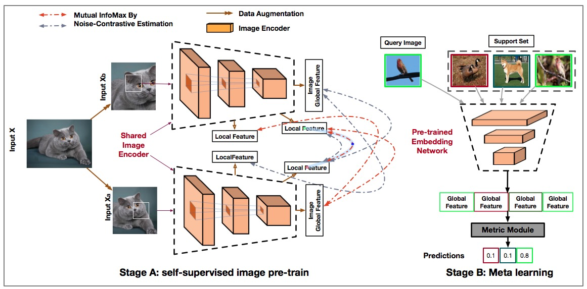
AMDIM Compare and Process
AMDIM takes steps to avoid image fields overlapping too much
Extract features at different scales
Create feature vectors for each altered image
Compare dot products of feature vectors
Calculate loss with NCE Loss Function

Slide 13
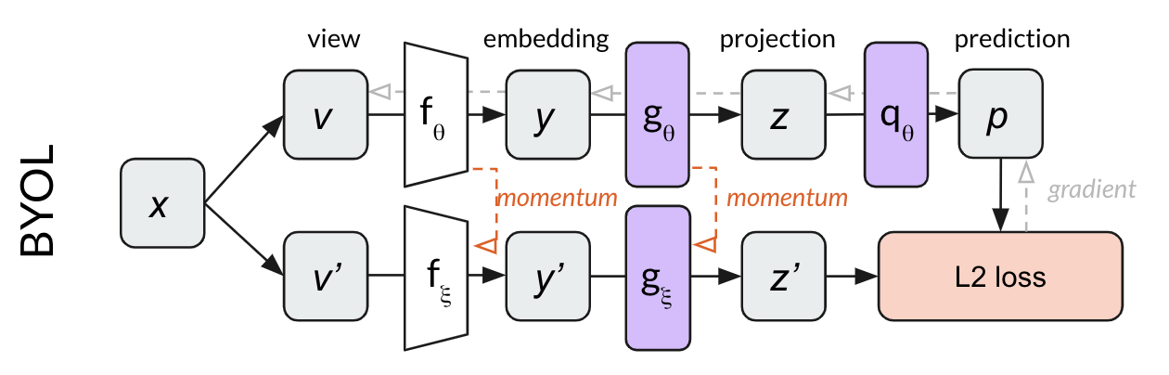
Bootstrap Your Own Latent (BYOL)
BYOL uses representation learning
Relies on two neural networks, referred to as online and target
Networks have two edited images
Networks interact and learn from each other
No negative images due to the two networks making up for it

Slide 14
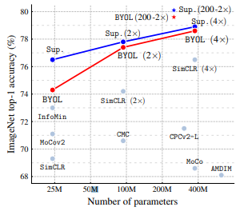
Bootstrap Your Own Latent (BYOL)
BYOL has a 74.3% top-1 accuracy on ImageNet
Accels in smaller batch sizes
BYOL achieves a new level of learning without negative data

Slide 15
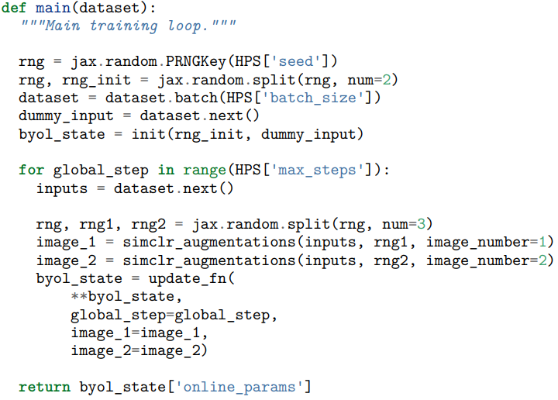
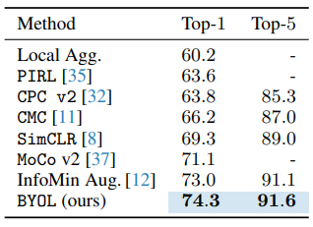
Bootstrap Your Own Latent (BYOL)
Small sample of training BYOL in JAX
Squares up nicely with other methods
Can be applied in other non image related learning

Slide 16
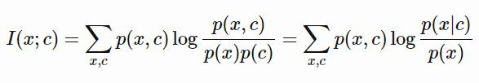
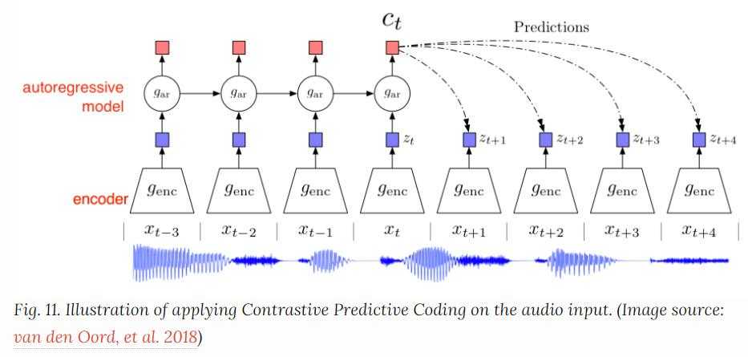

Contrastive Predictive Coding (CPC)
CPC stands for Contrastive Predictive Coding, representation learning method
The contrastive loss and InfoNEC loss
Encodes the input data and decodes
Comparison with direct :

Slide 17
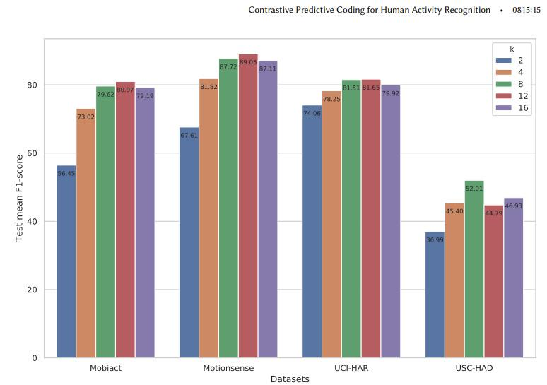
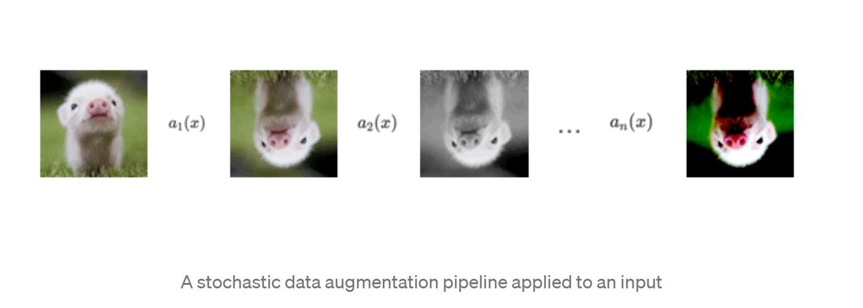
Contrastive Predictive Coding (CPC)
Advantage:
high amount of virtual movement data
Disadvantage:
performed less than those performed on real IMU data
New techniques of CPC
A(x), a data augmentation pipeline

Slide 18
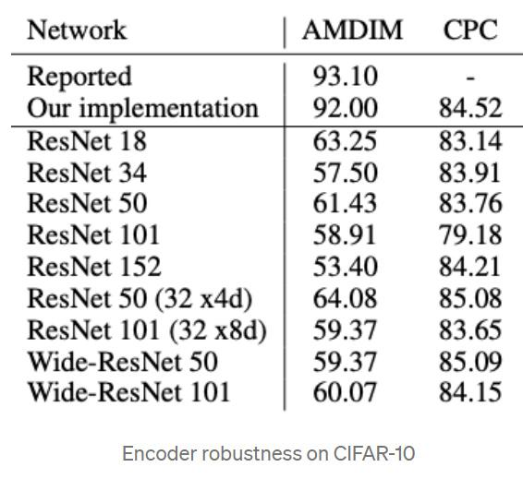
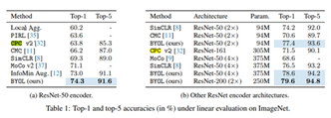
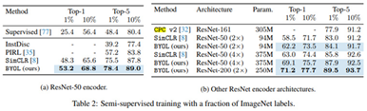

Contrastive Predictive Coding (CPC)
First way to differentiate approaches: pipeline
-AMDIM has the best pipeline
Second way to differentiate approaches: type of encoder
-AMDIM vs CPC with encoder robustness on CIFAR-10
Performance on Linear evaluation and Semi-supervised training on ImageNet
Comparison between CPC and SimCLR

Slide 19
Comparison
AMDIM
best performance
needs more negative images
SimCLR
simple (doesn't need special memory architectures)
needs way larger batch sizes, but maybe best if large batch size (negative data needed)
SwAV
works with any batch size (adaptable)
less efficient
BYOL
doesn't need as many negative examples
delicate fine tuning required
CPC
more robust with change in encoder
inferior to AMDIM

